Slide 1
Adding functionality
Lecture #6

Slide 2
Buttons

Slide 3
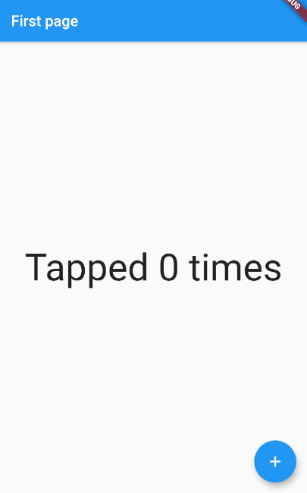
Buttons
Let’s implement this real quick. We want to do something when the button is pressed

Slide 4
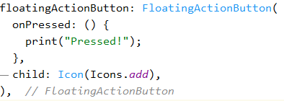
Button action
For that we use the onPressed property, which takes in a function.

Slide 5
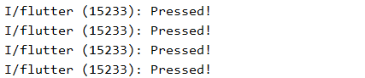
Button action
Result:

Slide 6
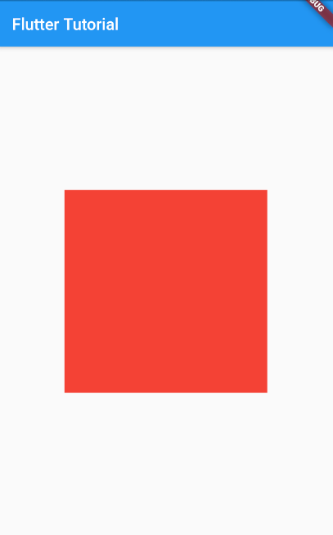
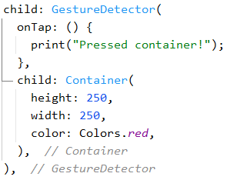

Gesture detector
Pro tip:
You can add functionality to any widget by wrapping it in a GestureDetector and filling the onTap property:

Slide 7


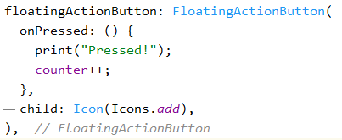
Buttons
Now, we need to change the text.
For that:
Create variable counter and initialize to 0.
Edit text to include that variable
Edit onPressed function to increment it.
Press the button and try it out!

Slide 8
Stateful Widgets
Of course nothing happens!
It is because the UI does not update unless we tell it to.
And we do that by calling the setState function (which is only available for stateful widgets, if you are wondering).
setState recalls the build method only to update the parts of UI affected by the changed variable.

Slide 9
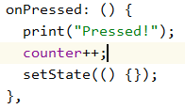
Stateful Widgets
If you are created a stateless widget by any chance (like I have), then place your cursor on StatelessWidget, press alt+enter, and select convert to statefulWidget
Update your code now. Type setS… and let your autocomplete handle the rest.
It works now!

Slide 10
Navigation

Slide 11
Navigation
But now we want to navigate to a new page and display this counter variable there.
Let's add a button to navigate to new page using Navigator.push()
The push() method adds a Route to the stack of routes managed by the Navigator.
Where does the Route come from? You can create your own, or use a MaterialPageRoute, which is useful because it transitions to the new route using a platform-specific animation.

Slide 12
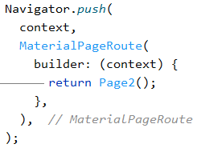
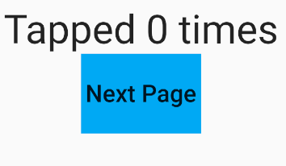
Navigation

Slide 13
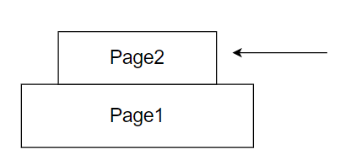
Navigation
This pushes page2 to the stack of routes.
We always get to view the top of the stack
To go back, either hit the back icon on the appBar, or add a button and call Navigator.pop(context) when pressed.

Slide 14
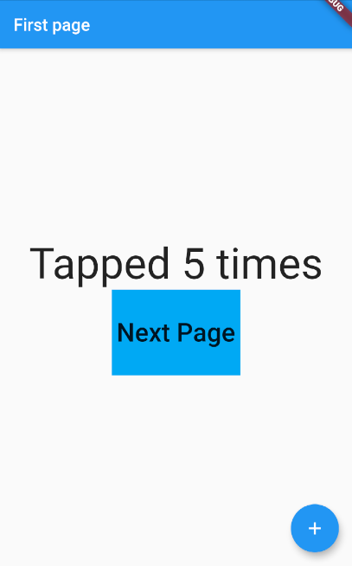
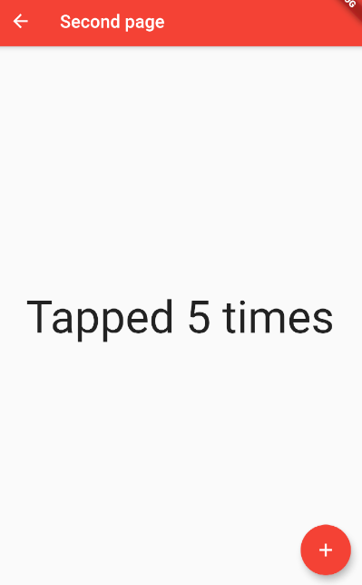
Result

Slide 15


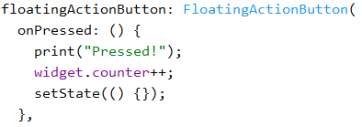
Sending data to child
Now, to carry the counter variable to the new page...

Slide 16
Updating parent data
And to carry it back, when we hit back, we see that there is no change to the first page.
This is because the second page received a copy of the variable counter. Whatever we did on the second page changed its copy only.
To solve this, we wrap the variable in an object and pass that instead.
Passing objects rather than primitive data types are more practical when building real software.

Slide 17
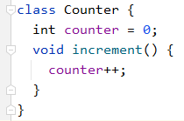
Updating parent data
So, a Counter class … (don’t confuse it with counter class already in dart lib)

Slide 18


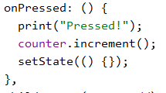
Updating parent data
… and refactoring existing code -
And it works just as fine now!

Slide 19


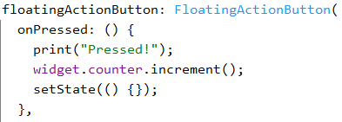
Updating parent data
… more refactoring (Page2)
And it works just as fine now!

Slide 20
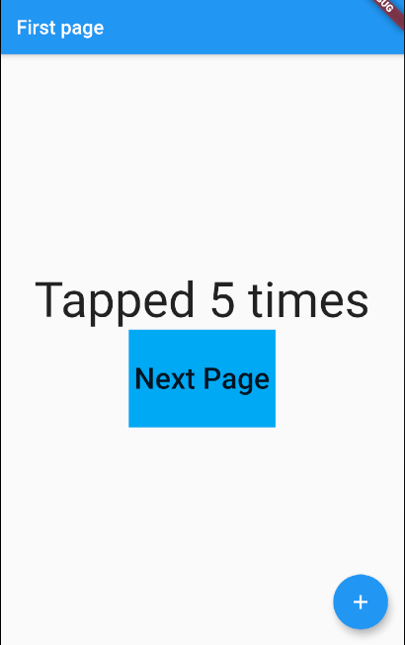
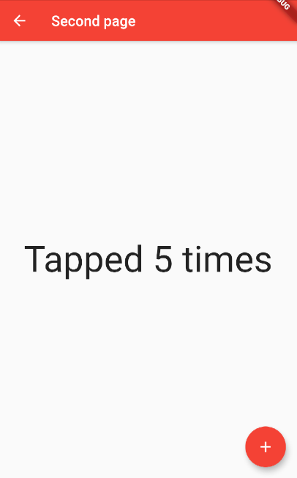
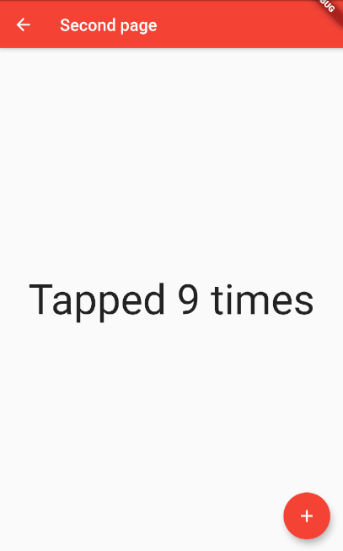
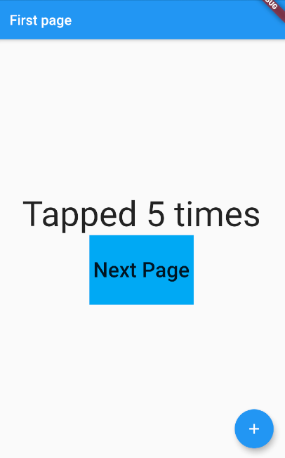
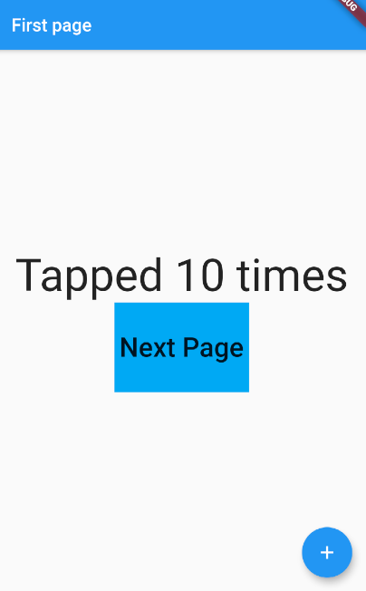
Updating parent data
Let’s test. Can you explain the results?

Slide 21
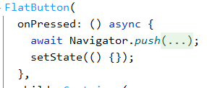
Updating parent data
Page1 is not updating the UI after Page2 is popped
Let's solve this. On Page1, bring this change -
Await pauses execution of this function till the execution of push() is finished.
I.e., till the new screen is popped and this Widget is at the top of the stack again.
After this, we call setState to update UI
And async is needed in any function that uses await.

Slide 22
Different ways of sending data back to parent

Slide 23
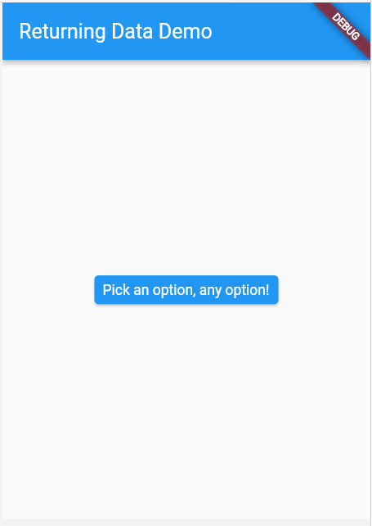
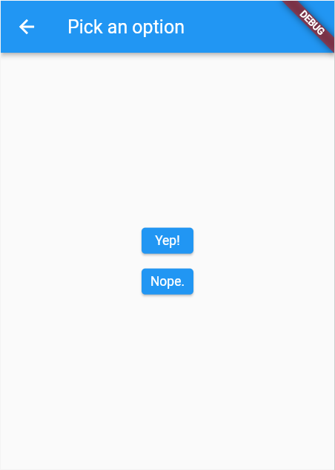
Lets try
Create a widget Page1 and add a button that navigates to Page 2

Slide 24
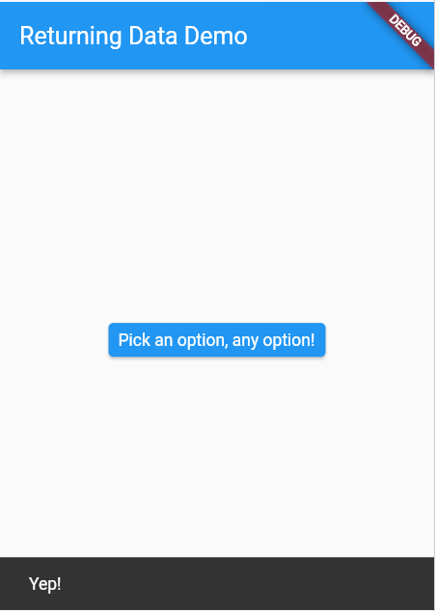
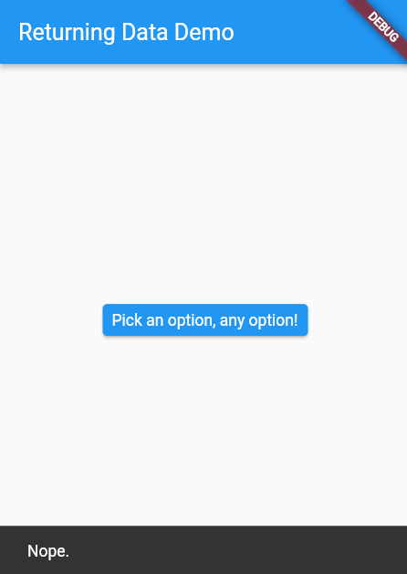
Lets try
Selecting any option from Page2 returns to Page1 and displays as such:
Nothing is displayed if the user presses back button instead

Slide 25


Solution
We do this for the buttons in Page2

Slide 26
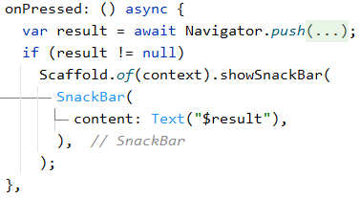
Solution
And We do this for the button in Page1 -
The returned value is null if the user clicks “back” from the app bar

Slide 27
OR

Slide 28


Alternate way of sending data
Create a variable in Page1 to store the result
Have Page2 accept a function from parent. This way we can make make Page2 execute any function from Page1

Slide 29
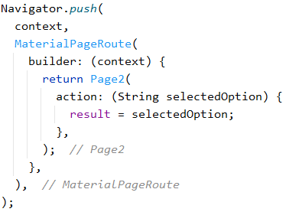
Alternate way of sending data
Back to Page1 (when navigating to Page2) -
“Result” is the variable declared in Page1 earlier. And the option selected in Page2 will be sent as parameter

Slide 30
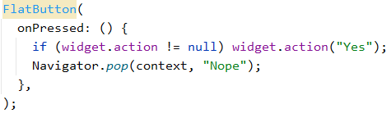
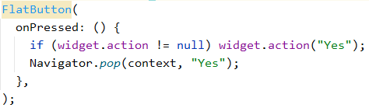
Alternate way of sending data
And in page 2,

Slide 31

Using the data
We now have the data sent to the parent, Page1.
Any subsequent actions, for instance - using the data to update the UI, can be written after “await Navigator.push(...” in Page1

Slide 32
But wait! There is more!

Slide 33
Buttons
There are many different types of buttons. I encourage you to read the documentation and try them out on you own.
Flat Button
Raised Button
Floating Button
Drop Down Button
Icon Button
Inkwell Button
PopupMenu Button
Outline Button

Slide 34
Thank you

